Slide 1
Salesforce Reference Architecture
(SFRA)
Onboarding Course
Simon Browne

Slide 2
Syllabus
Overview
Project Config & Dev Setup
Cartridges, Modules Folder, Middleware & Core concepts/patterns
Backend overview (controllers, routes, debugging)
Full stack code tutorial/introduction (+ Models, ISML, Objects & Forms)
OCAPI, headless, hooks & swagger
7. On platform feature overview (Content Slots, Page Designer, caching)
8. Environment differences

Slide 3
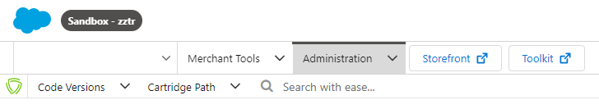
1.1 Overview – 3 components
Codebase > platform > knowledgebase
1. Storefront Reference Architecture (codebase)
-JavaScript, ISML, HTML, CSS, jQuery, JSON/XML configs
2. Business Manager (CMS, CRM, BUSINESS/ADMIN PLATFORM)
-Monster of a platform, (database abstraction, versioning, deployment, WebDAV server module management, website toolkit, automation, realtime services, CMS features – page designer, content slots, user admin, SEO)
Split into Merchant tools & Administration:
1. Merchant tools is the business user section, CMS etc
2. Administration = Developer/technical functionality
3. Infocenter & our confluence (knowledgebase) & SFRA git (cartridge repos)
https://documentation.b2c.commercecloud.salesforce.com/DOC1/index.jsp
https://theworkswiki.atlassian.net/wiki/spaces/DEVELOPMEN/pages/233013249/Salesforce+Live+Website (maintained by simon)
https://github.com/orgs/SalesforceCommerceCloud/sso
Also: Aaron & Simon – working on website for a bit

Slide 4
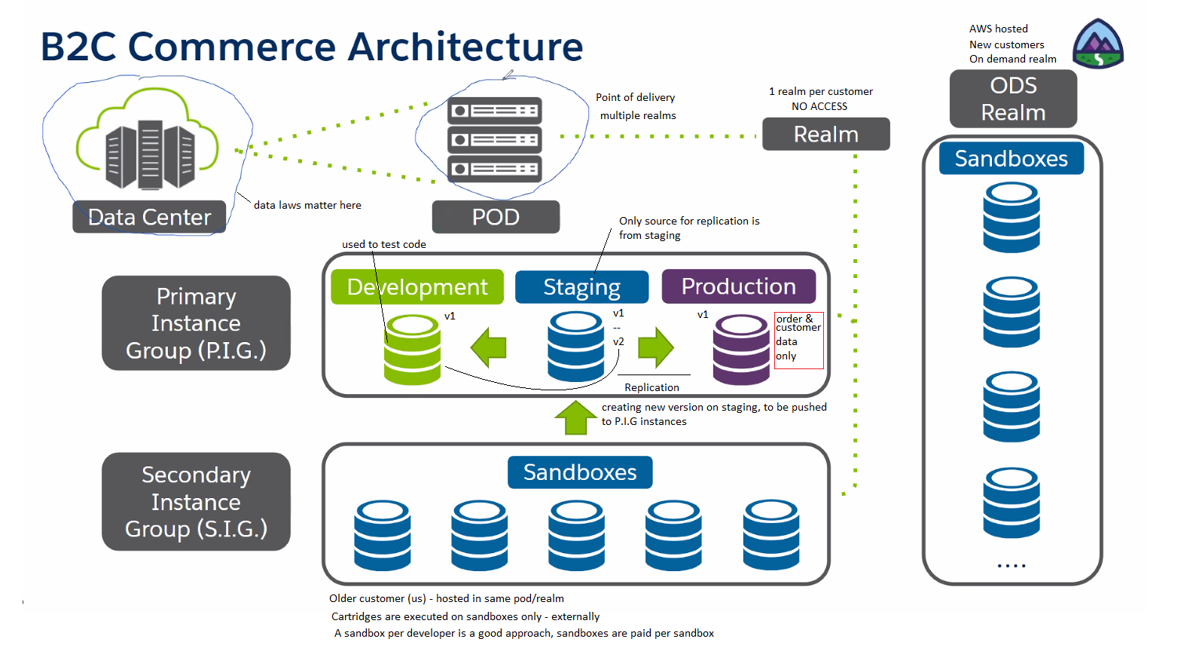
1.2

Slide 5
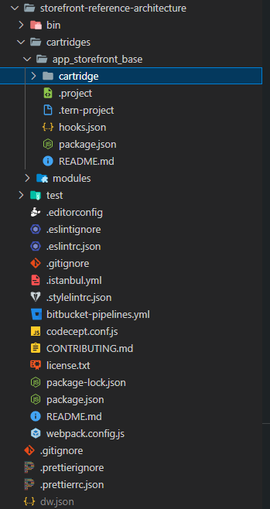
1.3 SFRA & Sandboxes = Developer?
What is SFRA?
Out-of-the box blueprint for an ecommerce website. Salesforce have provided us with a live ecommerce website solution which operates based on their SFRA architecture.
What is a Sandbox?
A sandbox is a development server/instance is provided to a developer working on SFRA – the salesforce ecommerce solution. We have 9 – they all cost money.
A sandbox is not a local server, it is hosted.
…..?
Yes, your JavaScript code is written into an IDE (VSCode), uploaded to an external development server (sandbox), which becomes instantly available for you to see executing – if its correct ☺

Slide 6
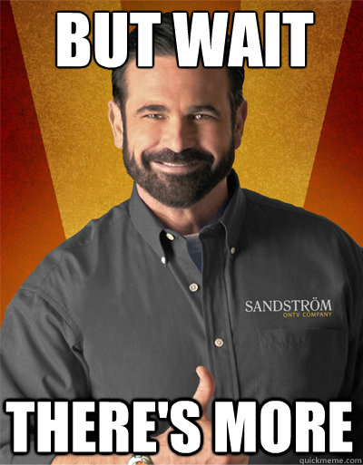

Slide 7

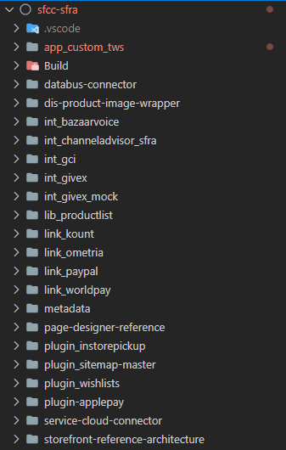
1.4 SFRA & Sandboxes = Developer? (Cont’d)
What is a cartridge?
A loosely coupled software module. SFRA is subject to modular design, a cartridge encompasses frontend and backend code along with configuration & ultimately – whole features.
Our website theworks.co.uk is made up of x20 cartridges (software modules).
1x base cartridge
4x plugin cartridges
4x link cartridges
5x integration cartridges
1x custom cartridge

Slide 8
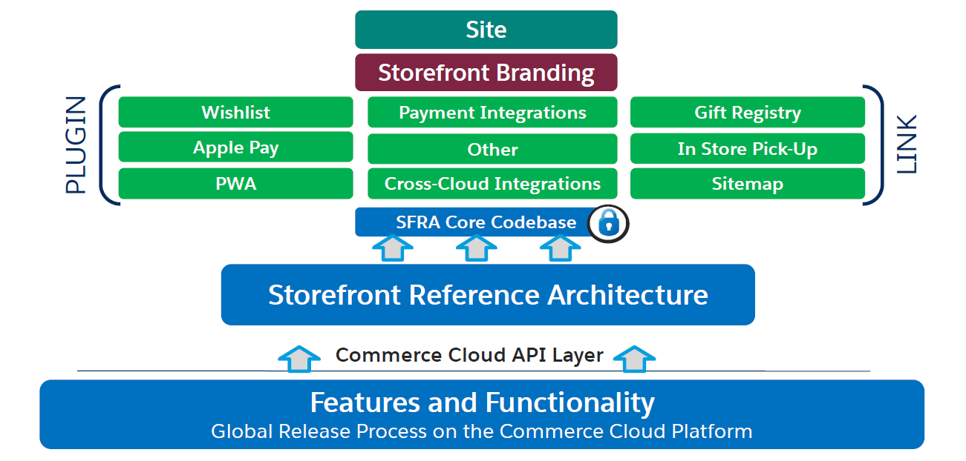
1.5 SFRA – A Typical Cartridge Stack
More on cartridges later

Slide 9
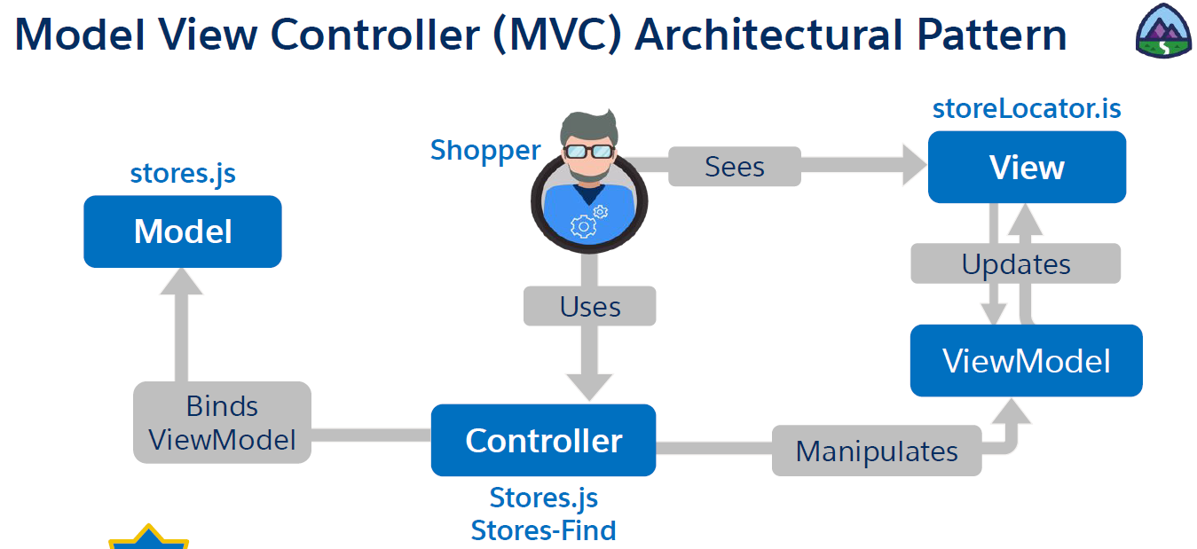
1.6 Website Architectural Pattern

Slide 10
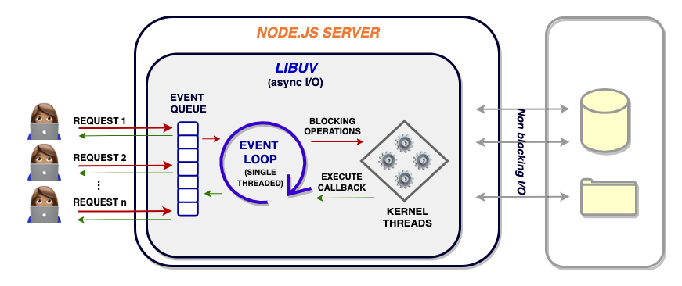
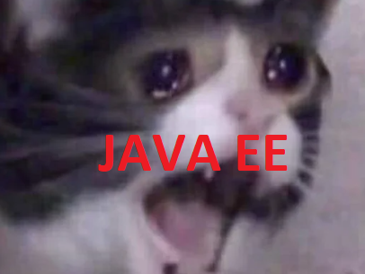
1.7 JAVA vs JavaScript
JavaScript frontend & backend you say?
Node.js you say?
Well, better get ready for some Node.js server runtime code.
NOPE.
Expectation
Reality

Slide 11
1.8 JAVA vs JavaScript (Cont’d)
What does this mean? Why does this matter?
In OrderController.js:
var Money = require('dw/value/Money');
var BasketMgr = require('dw/order/BasketMgr');
var Transaction = require('dw/system/Transaction');
var URLUtils = require('dw/web/URLUtils’);
The dw. – namespaced code is called B2C Commerce Script, its part of the B2C Commerce API that Salesforce provide. These classes/packages are extended to us from Salesforce, we MUST use them to implement on the website.
Salesforce are an enterprise level organization & have decided to transpile JavaScript into JAVA on the server – likely because their architects are enterprise architects and JAVA is their primary language.
Refer to dukescript, TeaVM, GWT etc for more information on transpiling JS into other languages – if interested.
Code written based on the B2C Commerce API is - open for extension & not modification (OCP)

Slide 12
1.9 Backend Overview
The backend is developed in JS
Backend is composed of:
-modules folder (middleware, server & core definitions)
-controllers
-helper classes
-models
-various design patterns (i.e. productFactory)

Slide 13
1.10 Frontend Overview
The frontend is written in HTML, CSS, ISML, JS, JQuery, XML/JSON
Frontend is composed of:
-HTML pages
-ISML template views
-js helper scripts
-XML/JSON config

Slide 14
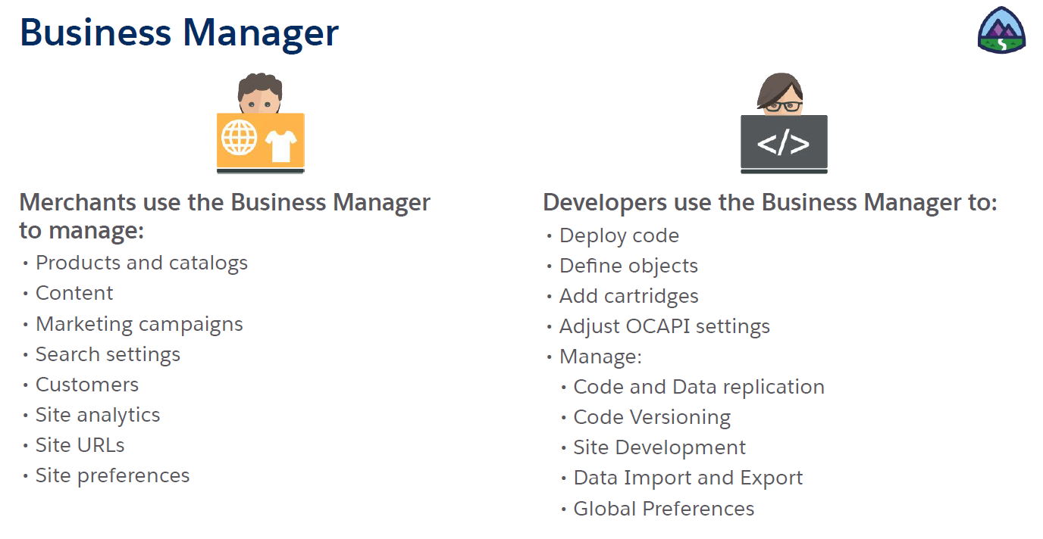
1.11 Business Manager

Slide 15
1.12 Platform - Demo
Time to have a look around Business Manager.
-cartridges ()
-system objects
-catalogs
-custom preferences
-search indexes
-replication
-code/version deployment
“Configuration over coding” -Salesforce

Slide 16
1.13 - Recap
Name the architectural pattern used in SFRA?
What is a cartridge?
What is B2C Commerce Script and how is it used?
What are the core technologies of the frontend?
What are the core technologies of the backend?

Slide 17
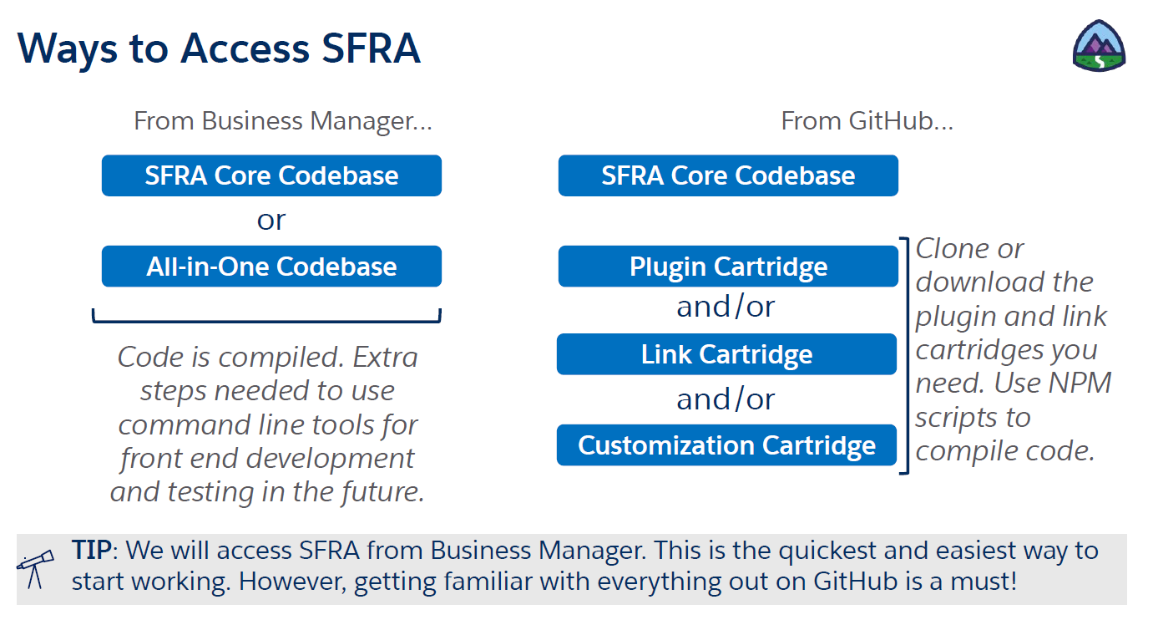
2.1 Dev Setup & access to code
Confluence for dev set up & connecting to sandbox process here:
https://theworkswiki.atlassian.net/wiki/spaces/DEVELOPMEN/pages/235798589/Development+Environment+Setup+Configuration
-Install VSCode
-Install plugins/extensions
-connect it to sandbox
-Get to grips with CLI
Two ways to get hold of code for your platform.
Business Manager
GitHub Repos

Slide 18
WARNING – DON’T IMPORT A DEMO WEBSITE IT SLOWS DOWN YOUR SANDBOX! SANDBOXES ARE SUBJECT TO DATA QUOTAS & EACH ONE IS A PAID FOR RESOURCE
2.2 Next Steps
So far, we’ve learned that we can host websites on a sandbox, upload versions, authenticate & configure whatever we want.
Next steps would typically be:
-Create a demo website
-Go through building an example project
But.. We can’t.

Slide 19
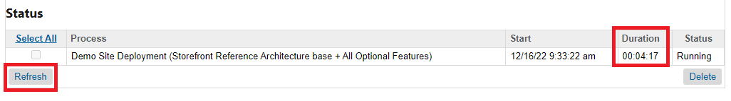
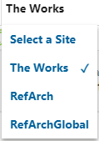
EXAMPLE - Importing a demo website
Setting up a new website, GO TO:
A. In Business Manager, select Administration > Site Development > Site Import & Export.
B. Select Storefront Reference Architecture Demo Sites.
C. Click Import.
D. Select Storefront Reference Architecture base + All Optional Features.
E. Click Deploy.
F. Wait for about 15-20 minutes for import to finish.
G. Once the import is complete, you will see RefArch and RefArchGlobal under the sandbox Site dropdown.
H. Delete the RefArchGlobal site under Administration > Sites > Manage Sites.
When Complete

Slide 20
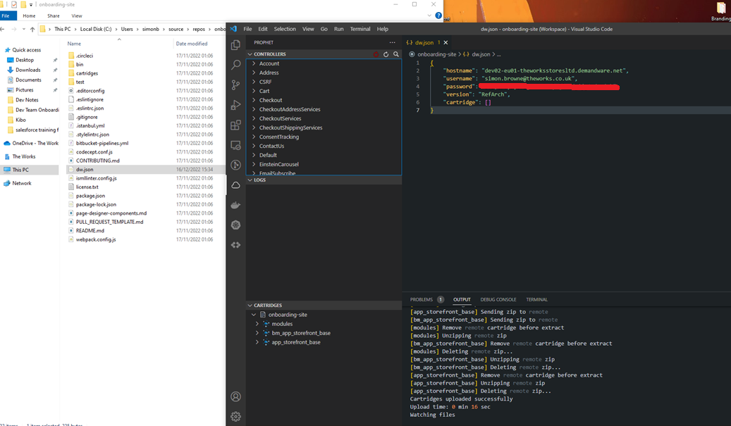
EXAMPLE - Workspace per code version
A new VSCode workspace is preferred for a separate code (version or website)
These workspaces will track different combinations of cartridges

Slide 21
EXAMPLE - Creating a new code version
Administration > Site Development > Code Version
Create a new code version called RefArch corresponding to the git repo downloaded.
Go to: Administration > Sites > Manage Sites
Select RefArch
Go to Settings, delete the cartridge path and add app_storefront_base as the only cartridge
Next, we need to enable our local codebase – to upload the cartridges into the version created earlier (the version is really just a file structure on the server enabled by webDAV)

Slide 22

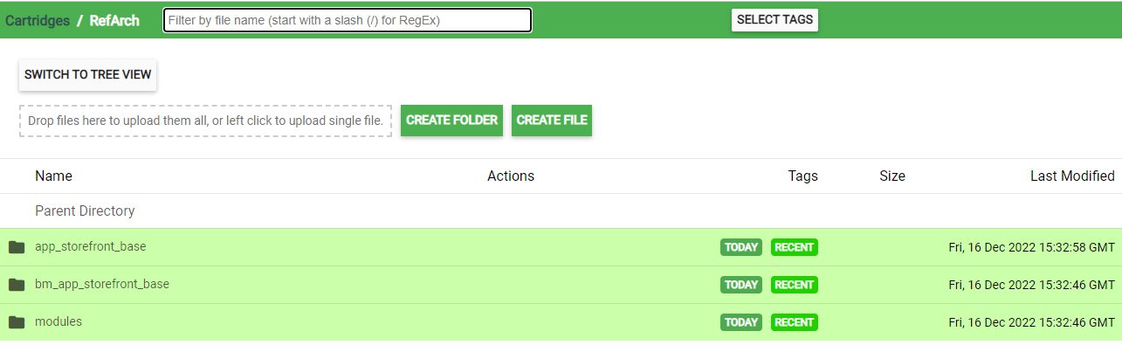

2.3 Development Setup
Administration > Site Development > Development Setup
This is where we upload our cartridges/code files to.
When you use prophet debugger, it uploads the files in your VSCode folder to the wevDAV allocated folder on the server – this is called a version
When something has been uploaded, it will appear in the directory to the left.
You can access this by clicking the folder icon on the cartridges section of Development Setup on platform

Slide 23
2.4 Development Guide
For additional help, I have written a comprehensive development guide, with all the help resources I could find:
https://theworkswiki.atlassian.net/wiki/spaces/DEVELOPMEN/pages/245399575/Development+Guide

Slide 24
2.5 Various Admin Tasks
Rebuild the search index:
Why? (UPDATE/REBUILD EVERY TIME YOU CHANGE PRODUCT ATTRIBUTES, db indexing)
merchant tools > search > search indexes
Create a new user:
Administration > Organization > Users
Assign roles & permissions:
Administration > Organization > Roles & Permissions
Ailases "Developer friendly URLs":
merchant tools > site preferences > merchant tools > storefront URLs

Slide 25
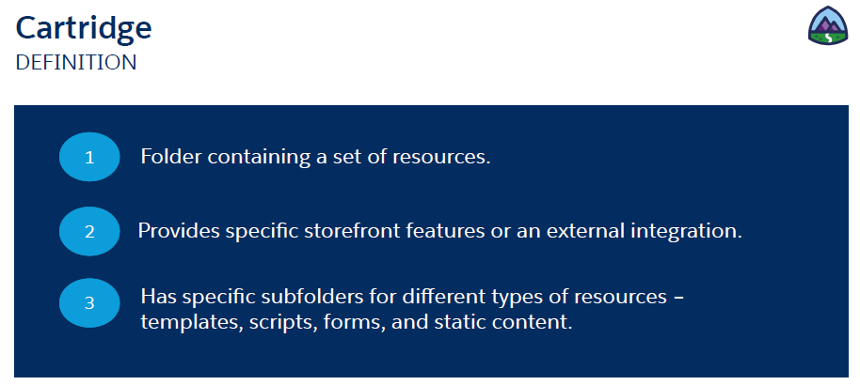
3.1 Cartridges?
Salesforce Definition:
Another Definition:
A software module, consisting of backend and frontend resources.

Slide 26
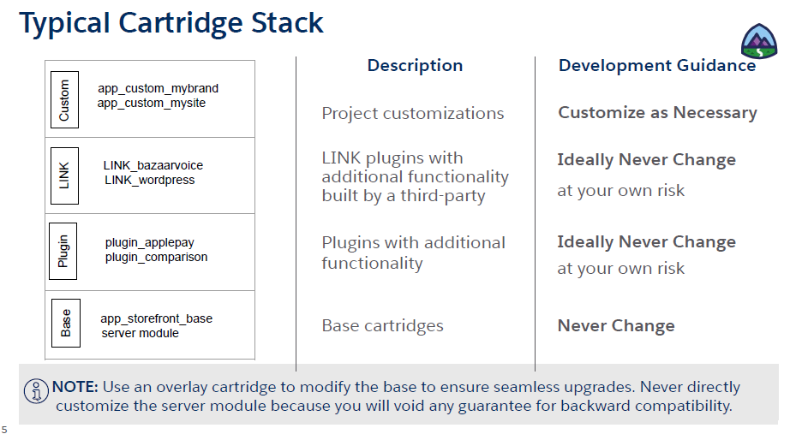
3.2 Cartridge Stack

Slide 27
3.3 Cartridge Path
The cartridge path refers to the sequential loading of cartridges (software modules)
There are different types of cartridge, (custom, LINK, plugin, base), for EXAMPLE:
app_custom_tws:ometria_sfra_changes:int_ometria_sfra:int_ometria_core:int_bazaarvoice_controllers:plugin_databus:int_databus:int_givex:plugin_instorepickup:int_bazaarvoice_sfra:bc_bazaarvoice:int_channeladvisor_sfra:plugin_dis:int_worldpay_sfra:int_worldpay_core:int_worldpay_csc:int_kount_sfra:int_kount:plugin_wishlists:lib_productlist:plugin_applepay:int_paypal_sfra:plugin_service_cloud:int_service_cloud:app_storefront_base:plugin_sitemap
app_custom_tws is the custom cartridge that Wunderman Thompson has been using to provide custom implementation for the website. This is declared as the leftmost software module:
POLYMORPHISM: This means app_custom_tws exists first, and therefore OVERRIDES the base cartridge in its intricacies.
INHERITANCE: For example the Account.js controller has a Login() method in the base cartridge (storefront-reference-architecture), in app_custom_tws it is “inherited” by creating another Account.js controller in the same folder structure. module.superModule() is what’s allowing the import of functionality. FOR EXAMPLE:
var base = module.superModule;
server.extend(base);
Polymorphism occurs through the server.replace() method. This allows overriding of method calls across software modules. This is deeper in the codebase, which is covered in a later slide.

Slide 28
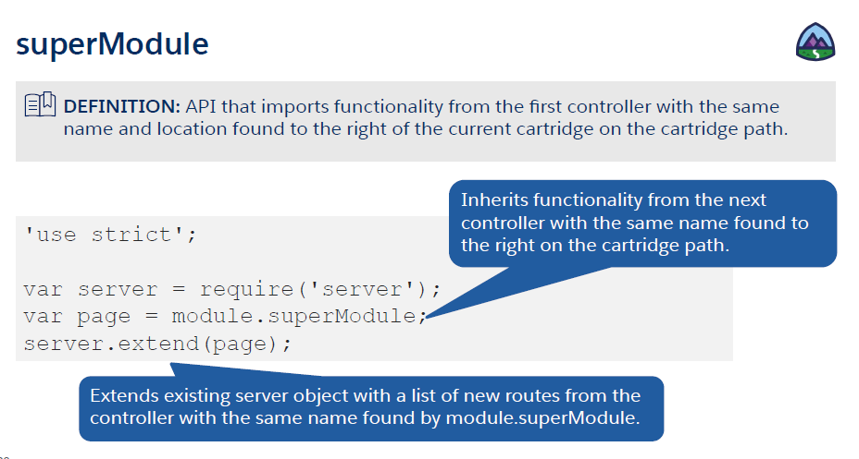
SuperModule

Slide 29
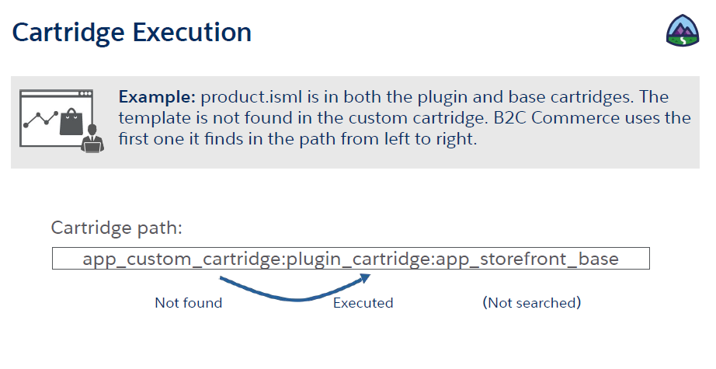

Slide 30
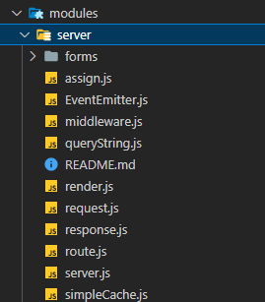
3.4 Modules
The modules folder is a special folder that only exists in the base cartridge of the solution. It contains the core definitions for the server, middleware, request, response, routes and render objects.
The prototypal inheritance pattern is strongly employed here to create a set of core definitions for the whole solution. The website and its behavior – especially the server is built on these definitions.
server.use()
server.get()
server.post()
server.extend()
server.prepend()
server.append() - decorator
server.replace()

Slide 31
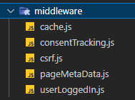
3.5 Middleware
cartridge/scripts/middleware
Definitions for:
caching, cookie consent, Cross Site Request Forgery token, page meta data, logged in status
These can be extended, instantiated and used across the website.

Slide 32
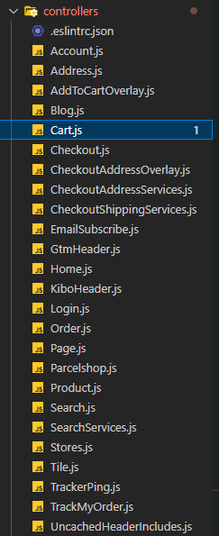
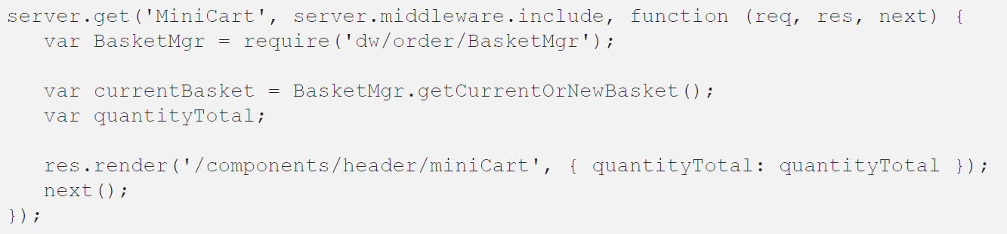
4. Backend Overview
Combination of controllers, helper scripts (multiple cartridges).
Written in “B2C Commerce Script” based on JavaScript
Controller Method Example:
Server.get(<route>, <middleware>, function(<request>, <response>, <next>))
Lets look at some of these parameters.

Slide 33
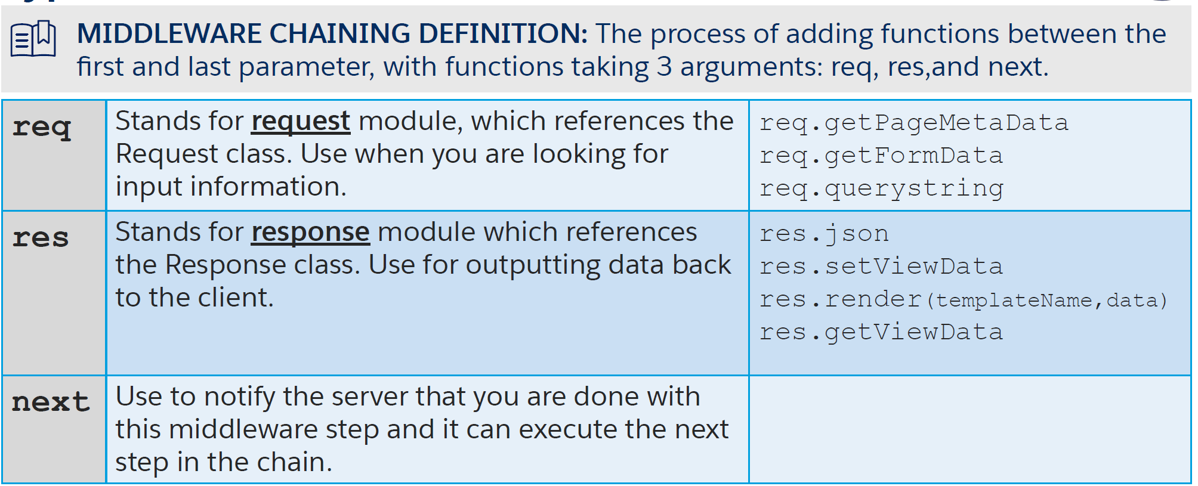
4.1 req, res, next
Request class: https://documentation.b2c.commercecloud.salesforce.com/DOC1/index.jsp?topic=%2Fcom.demandware.dochelp%2FDWAPI%2Fscriptapi%2Fhtml%2Fapi%2Fclass_dw_system_Request.html
Response class:
https://documentation.b2c.commercecloud.salesforce.com/DOC1/index.jsp?topic=%2Fcom.demandware.dochelp%2FDWAPI%2Fscriptapi%2Fhtml%2Fapi%2Fclass_dw_system_Response.html
Next():
https://developer.mozilla.org/en-US/docs/Web/JavaScript/Reference/Global_Objects/Generator/next
Layman Definitions:
The request class is typically HTTP requests received by the controller method, it contains values such as queryString, session, clientId.
The response class represents the HTTP response sent by the controller method. Typically used to render a view, send data, or sending a redirect.
The next() object is built into JavaScript and derives from the Generator pattern. In this solution it is set up in a chain of responsibility pattern – one module calling to the next() in a sequential fashion.

Slide 34
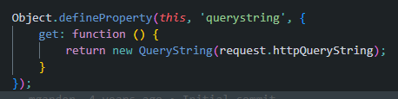
4.1 Cont’d
You can find the code for Request, Response, Server in the Modules folder.
Within the SFRA base cartridge.

Slide 35
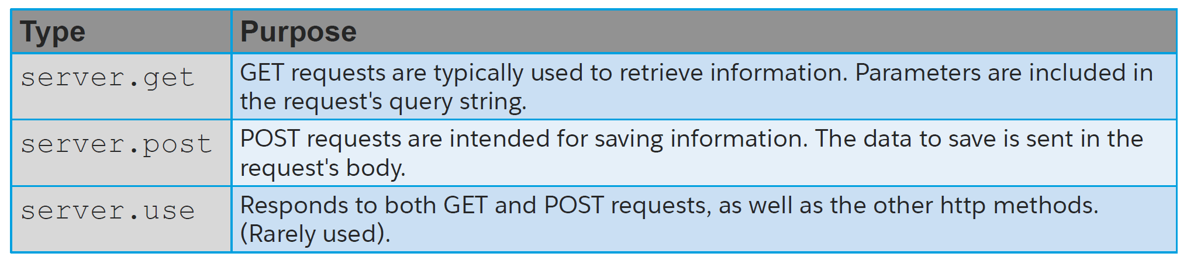
4.2 get, post, use
.get() – HTTP GET
.post() – HTTP POST
.use() – HTTP GET POST PUT PATCH DELETE OPTIONS

Slide 36
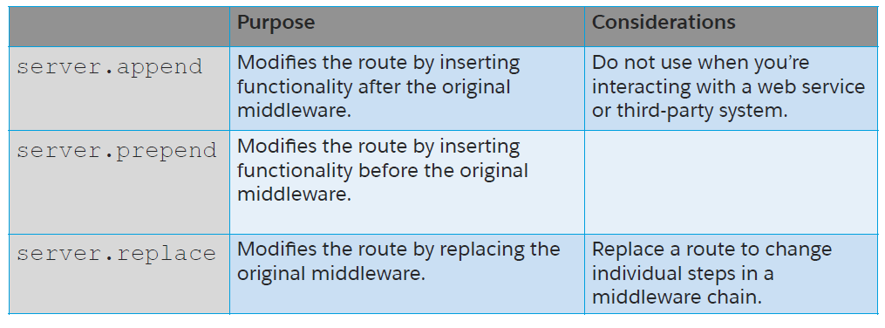
4.3 append, prepend, replace

Slide 37
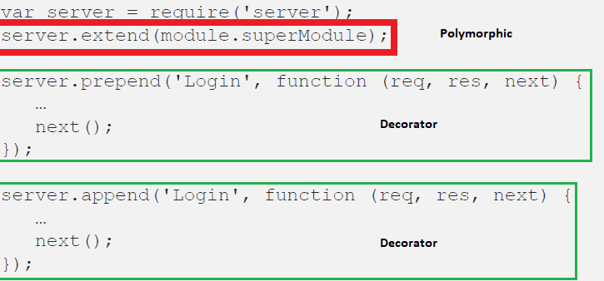
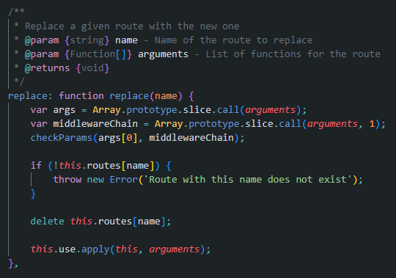
4.3 cont’d
Server.replace() takes the prior call/method, and just adds another execution step to the controller/route call
The cluster of execution will be clarified next slide:

Slide 38
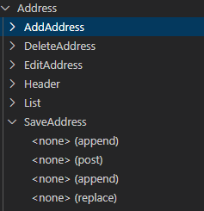
4.4 Execution & chain of responsibility
Prophet debugger allows us to see:
-Controller (Address)
-Routes (AddAddress.. etc)
-Thread of execution (append, post, append, replace)
In this case. The endpoint for address (SaveAddress) has x2 appending functions executing, a POST executing and then after this, a replace function is happening.
This sequence is important when considering bugfixing, debugging, or new development tasks on the backend.
Next() is getting called, at the end of every function call, this chaining is a chain of responsibility pattern – each prior function must not fail, otherwise the chain will be broken and errors will cripple the server

Slide 39
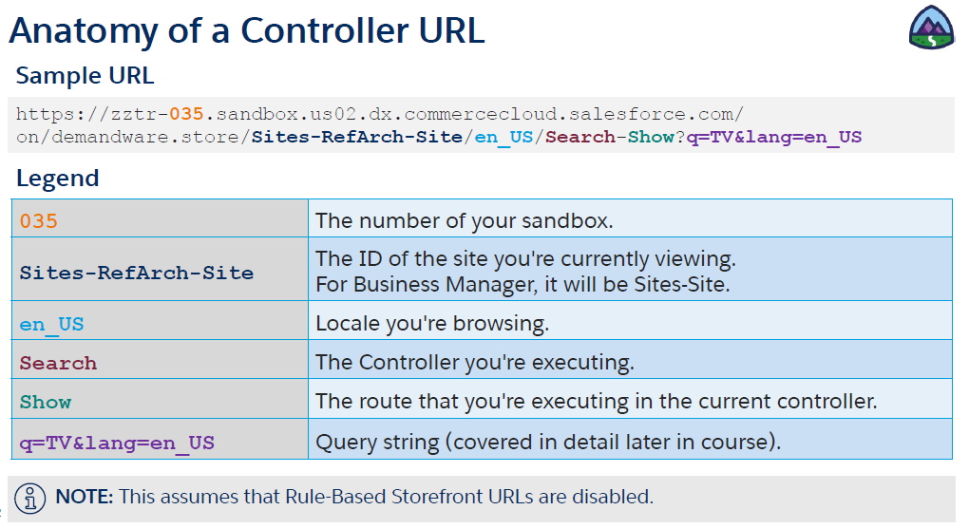
4.4 controller URL structure

Slide 40
5. Code Tutorial
Exercise 1 - Create a test controller & print hello world to the sandbox.

Slide 41
5.1. Exercise 1
Create a test controller & print hello world to your sandbox
'use strict';
var server = require('server');
server.get('showAction', function(req, res, next) {
res.print('<html><body><h1>Hello World</h1></body></html>');
return next();
});
module.exports = server.exports();
https://dev02-eu01-theworksstoresltd.demandware.net/on/demandware.store/Sites-TWS-UK-Site/en_GB/testController-showAction

Slide 42
5.2. Exercise 2
Write your name using .isml template & set request object via querystring
In testController.js
server.get('showIsml', function(req, res, next) {
var req = req.querystring.name; //?name=yes
var name = "Simon";
res.render('testIsml', {param1: "hello from ", param2: name, param3: req});
next();
});
Create file in (templates/default/) called testIsml.isml
<html>
<body>
<h1>${pdict.param1} ${pdict.param2} ${pdict.param3}</h1>
<p>pdict stands for Pipeline Dictionary.</p>
</body>
</html>
https://dev02-eu01-theworksstoresltd.demandware.net/on/demandware.store/Sites-TWS-UK-Site/en_GB/testController-showIsml?name=yes
Use querystring in address bar to set the req obj property.

Slide 43
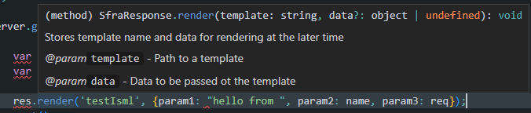

.isml & pdict
.isml is the template language that Salesforce have provided for this solution. Isml templates are backend templates, that render on the frontend:
This is quite similar to
razor templates in ASP.NET MVC
Pdict stands for Pipeline Dictionary. It is a data structure very similar to view data in ASP.NET MVC. It is a hash map that operates between the controller and the .isml (dynamic front end template).
Res.render(<template name>, <data>)
Controller (pipeline dictionary)
view (pipeline dictionary)

Slide 44
List of .isml tags
List.. pending

Slide 45
5.3. Exercise 3
Do a bit of styling using the in-solution SASS with .isml decorators
Create file in (scss/components) called test.scss & include it in global.scss
.headerTestClass {
width: 100%;
background-color: aqua;
}
.bodyTestClass {
width: 100%;
background-color:bisque;
}
Amend testIsml.isml
<isscript>
var assets = require('*/cartridge/scripts/assets.js');
assets.addCss('/css/global.css');
</isscript>
<isdecorate template="common/layout/pageNoMargin">
<div class="container">
<h1 class="headerTestClass">${pdict.param1} ${pdict.param2} ${pdict.param3}</h1>
<p class="bodyTestClass">pdict stands for Pipeline Dictionary.</p>
</div>
</isdecorate>
https://dev02-eu01-theworksstoresltd.demandware.net/on/demandware.store/Sites-TWS-UK-Site/en_GB/testController-showIsml?name=yes
Run commands* to build sass – css,

Slide 46
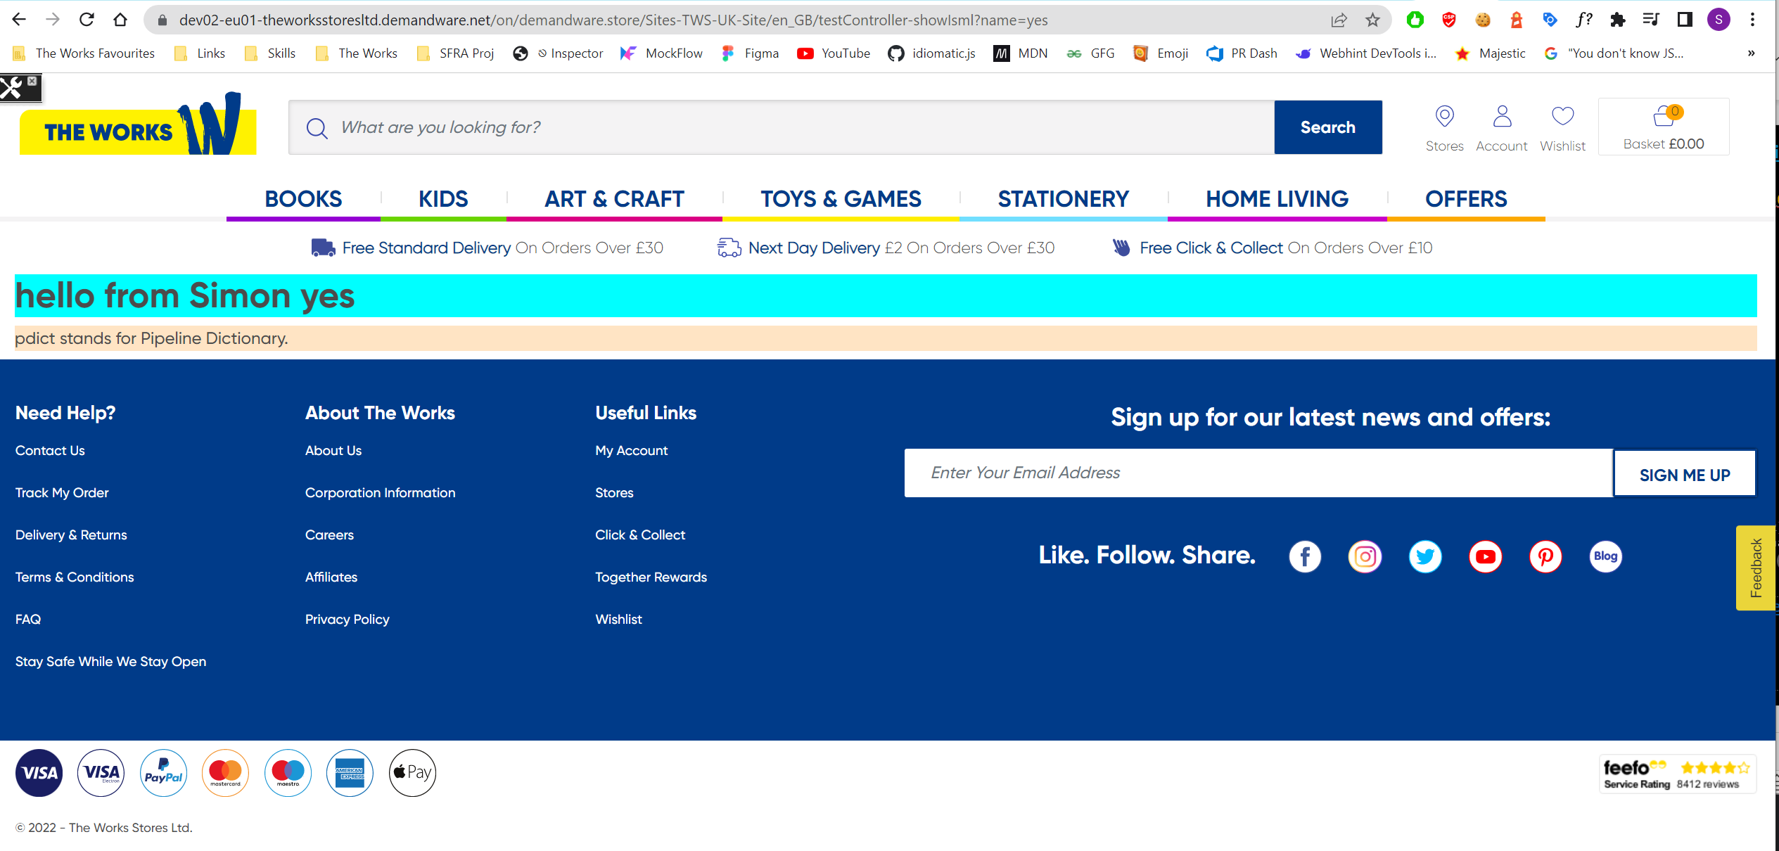
5.3. Exercise 3 - Result

Slide 47
5.4. Exercise 4
Using pipeline dictionary to manipulate view pdict & .isml tags demo

Slide 48
6. Frontend Overview
Non practical description of how the frontend works

Slide 49
7. OCAPI, headless, hooks & swagger
Not really used in solution yet

Slide 50
8. On platform feature overview
Page Designer
Content Slots
Jobs & job steps (automation)
Einstein
Resource types, localization
Endless isle
Salesforce support resources (code updates)
Logging

Slide 51
9. Environment differences
Sandbox | Dev01 | Staging | UAT | Production
Low amount of Data | staging data | Data from the works daily | Data replicated from staging daily | Data replicated from staging daily
no caching | caching varies, on or off depending on testing | no caching | caching | caching
Alias URL switched off | Alias URLs varies | Alias URLs on | Alias URLs on | Alias URLs on
no reports | no reports | no reports | no reports | historical reports (analytics > technical reports)
toolkit | toolkit | toolkit | toolkit | no toolkit
NOTE* Dont alter STAGING data as it gets replicated to UAT and Production daily

Slide 52
Syllabus

