Slide 1
Kibo API Implementation
Functional Requirements
Simon Browne

Slide 2

Kibo API Implementation – What?
No indication of what kind of implementation of Kibo API required for the business.
Social proof is some kind of social accounting system, you make an A/B change on the kibo platform, track data before an interaction and afterwards on our end, do some accounting by providing data to see if the experiment has worked.

Slide 3

Kibo API Implementation – How?
Kibo Implementation is proposed to take place via 4 key technical milestones:
Tag Installation (Synchronous)
MonetateQ API Implementation (Partial or Full) with trackData() calls
AJAX trackData() sync Implementation
Product feed (product data sent on a certain interval – for validation of social proof?)

Slide 4
1. Tag Installation
-synchronous tag, recommended on meeting by Rob, as it has a minimal performance impact and has no visual glitching associated (bug looks kind of like lazy loading)
-I decided to implement this via a custom site preference as per documentation: https://documentation.b2c.commercecloud.salesforce.com/DOC1/index.jsp?topic=%2Fcom.demandware.dochelp%2Fcontent%2Fb2c_commerce%2Ftopics%2Fisml%2Fb2c_isprint.html
-----CONFIG
1.1 Administration > SitePreferences > System Object Types > new
1.2 ID (MontateTag) > Type (Text)
1.3 Merchant Tools > Site Preferences > Custom Site Preference Groups > new
1.4 use the newly created system object attribute - enter the tag in "value" text field
**********
DATABASES? – system/custom objects are mapped into objects on the website
**********

Slide 5

1. Tag Installation (cont’d)
*****
CODE
*****
1.5 enter expression in htmlHead.isml <isprint value="${dw.system.Site.current.preferences.custom.MontateTag}" encoding="off" /> (<isprint> is used to format and encode data for output.)
1.6 Add <attribute-definition> & <attribute-group> in system-object-definitions.xml

Slide 6
2. MonetateQ API Implementation
GOAL: Persist window.monetateQ data object across the website, available to push() data into. Very similar to dataLayer for Google Analytics.
// Product Page Example
window.monetateQ = window.monetateQ || [];
window.monetateQ.push([
"addProductDetails", [{
productId: "pidString",
sku: "optionalSkuString"
}]
]);
window.monetateQ.push([
"trackData"
]);
NOTE** trackData method must be called after the relevant data from the correct area is allocated

Slide 7
2. MonetateQ API Implementation (cont’d)
KIBO have provided method calls per page listed below (hence my suggestion to break the epic down into a page by page implementation):
https://docs.kibocommerce.com/144073-method-calls-examples-by-page-type
-PDP (Product Detail Page)
-PLP (Product List Page)
-Purchase/Order confirmation
-Cart/checkout
-Any chosen page types (I have elected to begin with Home)

Slide 8
2. MonetateQ API Implementation (cont’d)
-Any chosen page types (I have elected to begin with Home)
setPageType() https://docs.kibocommerce.com/115695/638757-setpagetype
-PDP (Product Detail Page)
addProductDetails() https://docs.kibocommerce.com/115701/638800-addproductdetails
-PLP (Product List Page)
addProducts() https://docs.kibocommerce.com/115696/638788-addproducts
-Purchase/Order confirmation
addPurchaseRows() https://docs.kibocommerce.com/115706/638834-addpurchaserows
-Cart/checkout
addCartRows() https://docs.kibocommerce.com/115702/638810-addcartrows
-Additional
addCategories()
addBreadcrumbs()
trackData()

Slide 9
2. MonetateQ API Implementation (cont’d)
Core Implementation, technical scope:
Implementation of the following methods across various sections of the website, as well as a global array object to push the data into and a successive trackData() method – used to sync data with Kibo.
setPageType()
addProductDetails()
addProducts()
addPurchaseRows()
addCartRows()
trackData()

Slide 10
2. How?
**Technical Challenge time. Using SFRA – a Salesforce solution:
How to persist array object across website, available for data to be pushed into and sent to Monetate/Kibo?
How to get this data from the website?
Frontend, or backend?

Slide 11
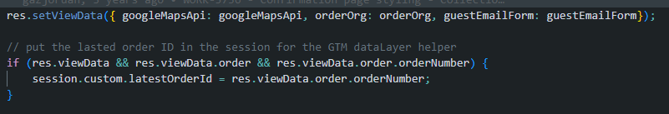
2. MonetateQ API Implementation (cont’d)
**Technical Challenge time. Using SFRA – a Salesforce solution:
How to persist array object across website, available for data to be pushed into and sent to Monetate/Kibo?
  Answer: Implement a <script> in the head with the .js in it, as per Kibos recommendation, across the website, available to pass data into.
How to get this data from the website?
  Answer: The data required for the Kibo API implementation should be present within the viewData data dictionary, in a similar fashion to ASP.NET MVC Framework web applications. This is referenced as a viewData object in the controller:
  A hashmap (data dictionary) data structure called $pdict allows .isml templates on the frontend to receive data Via expressions. You could call this an abstraction of a controller.
Frontend, or backend?
  Answer: Backend. The data is more structured and not subject to user interference.

Slide 12
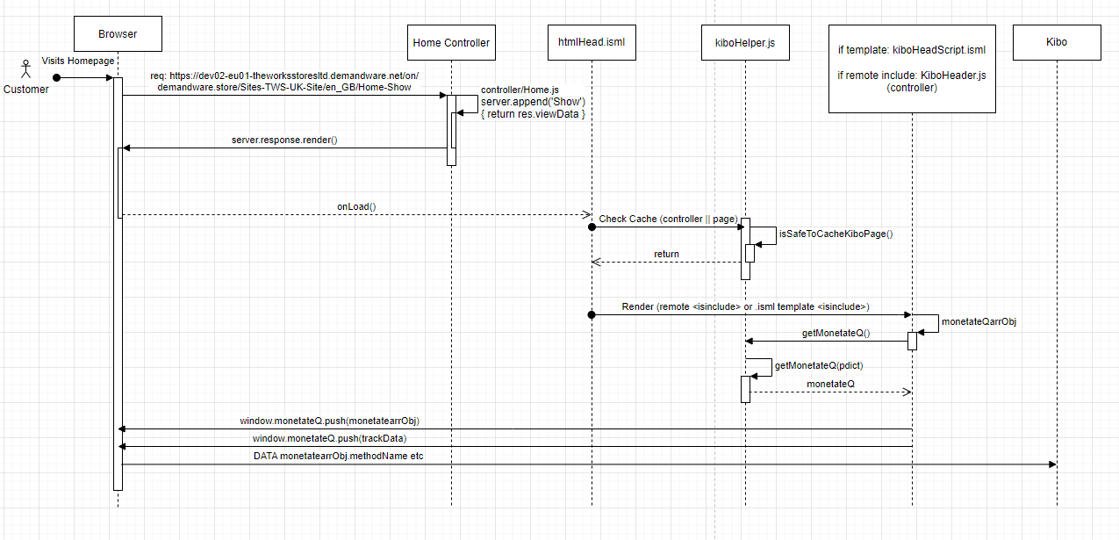
2. MonetateQ API Implementation (cont’d)
Sequence UML Diagram (Home API integration) for Jane

Slide 13
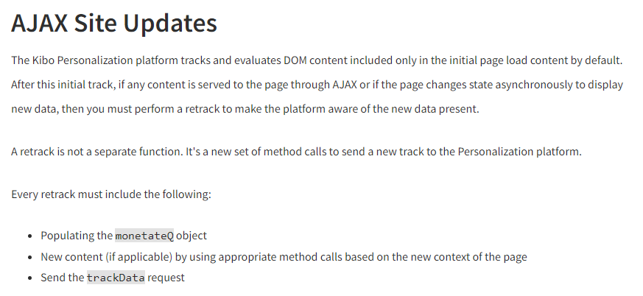
3. AJAX trackData() data synchronizing phase
https://docs.kibocommerce.com/115685-javascript-api-requirements/638694-ajax-site-updates
NOTE** The functional requirement here is the calling of trackData() ON THE FRONTEND across the relevant pages whenever/whenever the AJAX is firing (preferably once ☺)

Slide 14
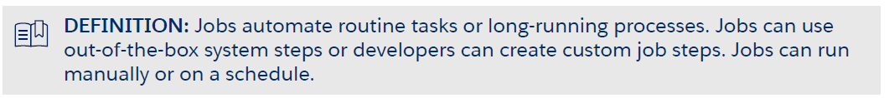
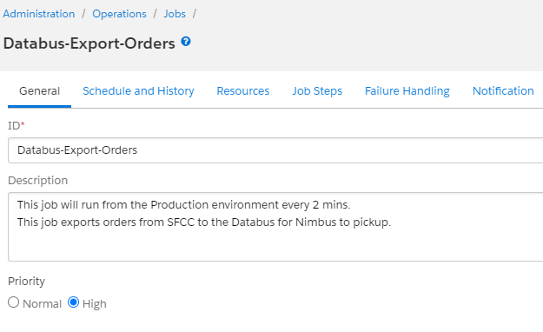
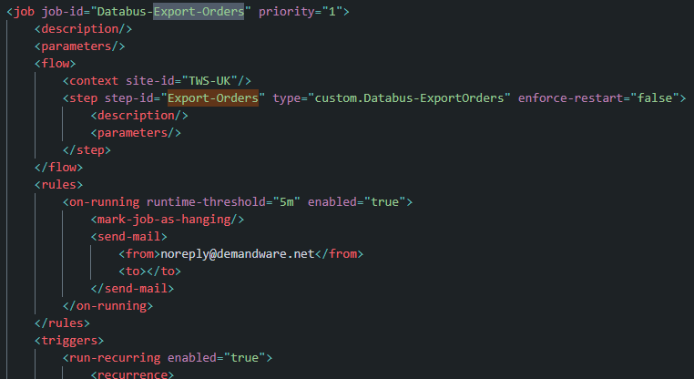
4. Product feed
Salesforce Jobs vs SSMS (service) – Lets investigate Salesforce Jobs
Configuration
Coding
(Administration > Operations > Jobs) Configuration of a step possible to use a flag on data to EXPORT data on a certain interval
WMT currently also have a service in place as well as a cartridge (databus-connector) dedicated to creating orders for export to the GCP queue

Slide 15
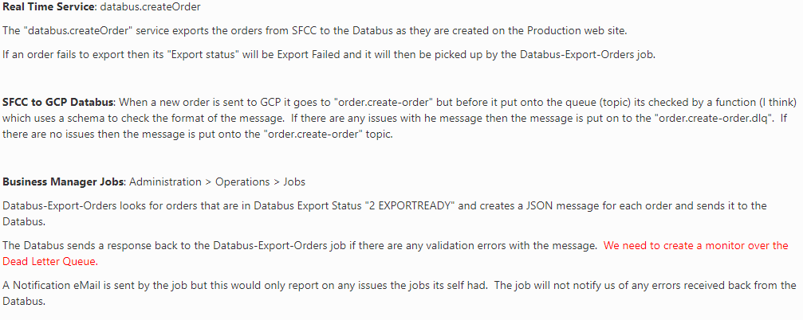
4. Product feed (cont’d)
(Administration > Operations > Jobs) Configuration of a step possible to use a flag on data to EXPORT data on a certain interval
WMT currently also have a service in place as well as a cartridge (databus-connector) dedicated to creating orders for export to the GCP queue

Slide 16
4. Product feed (cont’d)
Functional Requirement – For Salesforce product feed
Backend end implementation – orderMgr() implementation to trigger & generate order data that’s flagged in a custom way (with custom attribute). A database Transaction() to then send the data into the database (which is set up and managed on platform).
Administration > Operations > Services – A HTTP service live to allow this to happen.
Administration > Operations > Jobs – A new job used to automate the export of the data to databus on whatever designated interval.

Slide 17
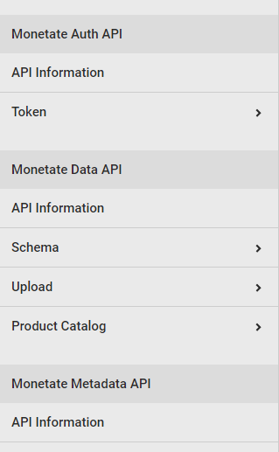
Final/Misc Considerations
Engine API (Used to be called Decision API) – Appears to be in place for more specific business requirements, I am unsure if it is a requirement
Functionally requires headless development – which the platform has capability of via OCAPI but is completely empty and unused.
David has told me WMT will be having a meeting soon to start implementing more of a headless solution which seems a bit late.
https://docs.kibocommerce.com/115777-the-engine-api/812952-what-is-the-engine-api
https://docs.kibocommerce.com/115777-the-engine-api/1172051-set-up-an-engine-api-experience

Slide 18
Questions

