Slide 1

SEO Proposal
instantprint. 2021 ✨

Slide 2
Welcome All
Thanks for making the time!

Slide 3

SEO?
A series of technical challenges, that require a dynamic strategy and constant work to succeed

Slide 4
Issues with the existing SEO system
There are two sides to the SEO problem:
1. A lot of money currently being spent on an agency. (WMG Agency: Contracted at £24,900 per month)
2. There is only so much that money is doing, a website can only improve to a certain extent and a lot of the work can be and is done in house. It can potentially all be done in house if planned and executed correctly.
It is known that WMG also help with press releases, this is an unknown how it would affect this proposal.
Based on a past meeting with Claire there are issues with the agency model, the IP SEO process flows in a flawed way:
The agency identifies required changes to improve SEO
We get sent a report
Marketing raise tickets with spec
Claire / Martin feed back with queries or additional info required
More time can be spent at this point on clarifying details
We then face low SEO gain because the work is never implemented/low priority
Proposal
It is my view that the saving made from cutting the agency loose and focusing on SEO in house will pay off long-term as well as make substantial savings short-term for instantprint.

Slide 5
Current SEO Structure within IP
Name | Role | SEO Skills
Craig Wassell | Marketing Executive | Craig operates at a strategic level and is knowledgeable about multiple online platforms, keeps pace with changes in the google algorithm to some degree. Conceptually understands why SEO is so important and tries to forward the most relevant tickets for the website based on what the current agency recommend. Craig also works on off-site SEO and content marketing, which are both big areas in SEO.
Adam Lucking | PPC (Pay Per Click) Manager | A solid understanding of what SEO entails along with PPC campaigns.
Web Team (Claire, Martin, Owen, developers etc) | Web Team | A diverse and skilled web team.

Slide 6
A Future SEO vision for IP
6 Competencies
1. An understanding of SEO
2. On-site SEO
3. Off-site SEO
4. Technical SEO
5. Content Marketing
6. Comprehensive SEO analysis/monitoring/audit

Slide 7
1. An understanding of SEO
SEO people are required, may require upskill for existing employees but there are already a few with SEO skills in house. A new employee dedicated to SEO would understandably bolster this.
(Could be done in house, would help having a dedicated role)

Slide 8
2. On-site SEO
The optimization of website content and HTML.
Keyword research: Understand the language of your target audience.
Descriptive URLs: Ensure each URL is simple and descriptive.
Page titles: Use keywords naturally within the page title.
Meta descriptions: Craft meta descriptions like they were ad copy to drive clicks.
Content optimization: Sensibly use keywords and variations in your page copy.
Good user experience (UX): Ensure your site is a joy to use and navigate.
Strong calls to action: Make it easy for your users to know what to do next.
Structured data mark-up: Tap into the latest SERP (Search Engine Results Page) features to improve click-through rates.
Currently done by developers, as demonstrated.
(Could be done/maintained in-house)

Slide 9
3. Off-site SEO
Building authority to ensure Google stacks the deck in your favor.
Backlinks Authority: “Connect what should be connected”, connect the relevant affiliates to your website. If you have a real-world association with something, connect it. If not, then your backlink is fraudulent and will damage your website’s visibility.
Competitor Analysis: This is important for websites that are competing with and trying to gain an advantage over another competitor, for example, bananaprint.co.uk would be a substantial competitor of instantprint.co.uk.
Backlinks & authority, SEO off site is predominately handled by Craig and Adam.
(A dedicated role would bolster this)

Slide 10
4. Technical SEO
How well your content can be crawled and indexed.
Crawl: Can a search engine explore your site?
Index: Is it clear which pages the search engine should index and return?
Mobile: Does your site adapt for mobile users?
Speed: Fast page load times are a crucial factor in keeping your visitors happy.
Tech: Are you using search engine-friendly tech or CMS for your website?
Hierarchy: How is your content structured on your website?
Performed by developers/architects
(can and is done in-house)

Slide 11
5. Content Marketing
Having the most relevant and best answers to a visitor’s question.
Service content: What you do and where you do it.
Credibility content: Why a prospect should engage with your business.
Marketing content: Content that helps position you as an expert and puts your business in front of prospects earlier in the buying cycle.
Instantprint can and is creating its own content, Craig has a lot of experience in this area. Could use assistance, to ensure the content is SEO focused.
(could be done in-house, would help having a dedicated role)

Slide 12
6. Comprehensive SEO analysis/monitoring/audit
Reliable diagnostic analysis kept in line with the latest Google webcrawler changes is provided by the agency WMG. This analysis is very comprehensive.
(instantprint isn’t doing its own audits, but this could be done by a specific role created for it)

Slide 13
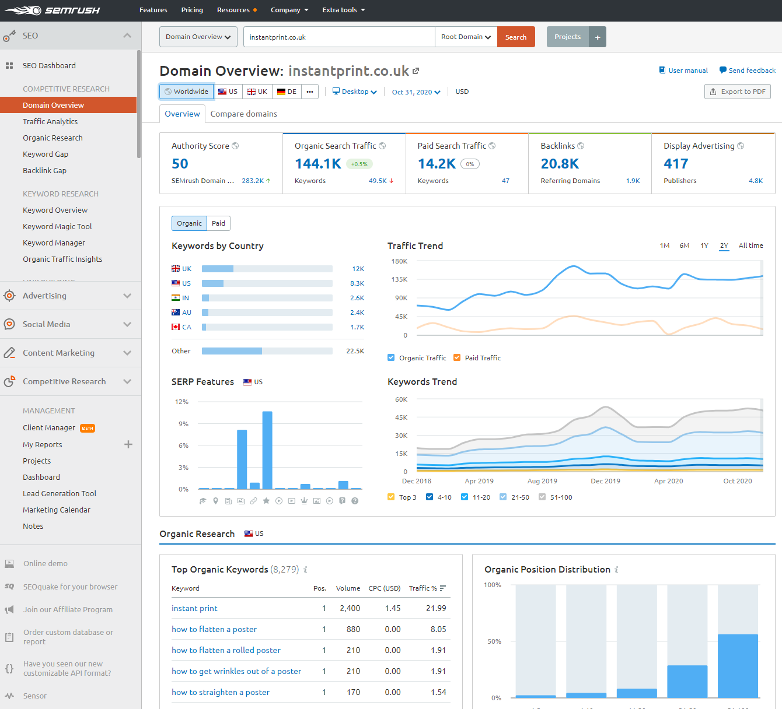
It took 5 minutes to input instantprint.co.uk into SEMrush to achieve comprehensive analytics akin to the data presented on the agency monthly SEO reports. The in-depth analysis techniques that I don’t know, an SEO manager will/should be equipped to know.
Simon Browne

Slide 14
Job Role Investigation
Based on the assertions of the previous section, a job role(s) would be required to replace the work carried out by WMG.
Indeed.co.uk (SEO Manager) 28k to 33k
Reed.co.uk (SEO Account Manager) 25k to 27k
Monster.co.uk (SEO Manager) 23k DOI
fish4.co.uk (SEO Manager) up to 35k DOI
technojobs.co.uk (SEO Outreach Specialist) 25k to 30k DOI
In a meeting with Adam & Claire, 45k was suggested for an SEO manager and 23k for an SEO focused developer, these figures are not set in stone of course.

Slide 15
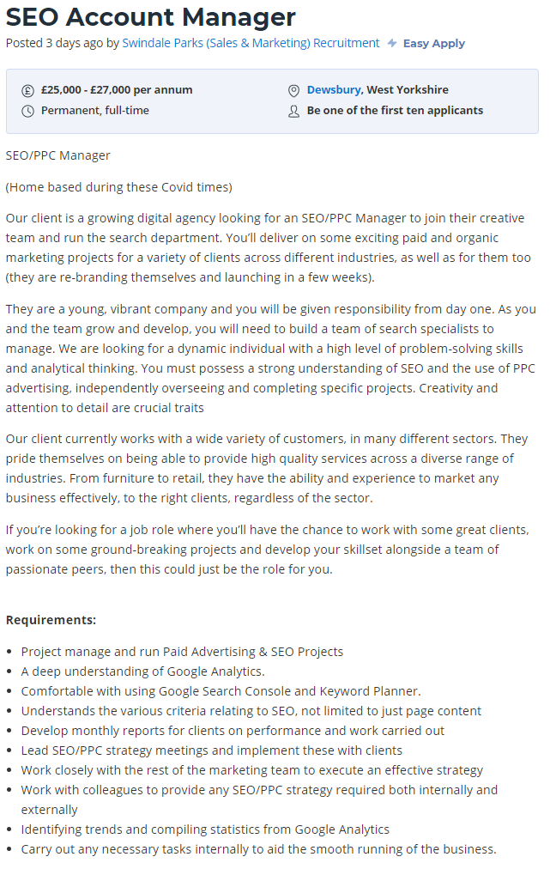
SEO Manager Job Samples
A lot of other companies do appear to be searching for SEO managers to help their brands grow and websites do better.
Some of the requirements:
A deep understanding of Google Analytics
Comfortable with Google Search Console, keywords etc
Lead SEO strategy meetings
Work with marketing and PPC teams to increase effectiveness
Identifying trends, feeding back and allocating tickets

Slide 16
Financial – SEO Costs Research
After looking around for general figures on how much SEO agencies cost businesses in the UK,
the following was found:
UK based SEO cost Averages in 2020:
Low End SEO: £1000
Mid-Level SEO: £2030 (£1160 + £2900/2)
High end SEO: min of £5200, max of £9000
Source | Low End SEO | Mid-Level SEO | High End SEO
(noisylittlemonkey, 2020) | £50 | £500 to £1500 | £1500 to £10000
(accelerate-agency.com, 2020) | £50 to £2000 | £2000 to £6000 | £6000+
(SEO Supremo, 2020) | £50 | £800 to £1000 | £1500 to £8000
(seoleaders.co.uk, 2020) | £500 to £2000 | £500 to £2000 | £10000+
(oneppcagency.co.uk, 2020) | £50 | £2000 to £4000 | £7000

Slide 17
Financial – Costing Breakdown
Currently WMG are contracted at £24,900 per month
WMG Annual Cost: £298,800
Projected cost for SEO manager and SEO developer (SEO Team): (45k + 23k /12) £5667 per month
SEO Team Annual Cost: £68,000 DOE
Per month we save: (£24,900 - £5667) £19,233
Per year we save: (£298,800 - £68,000) £230,800
Figures do not even take into account the wider benefit of a dynamic team and work that will be delivered.

Slide 18
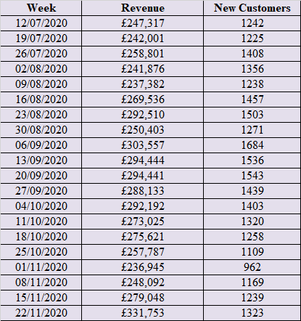
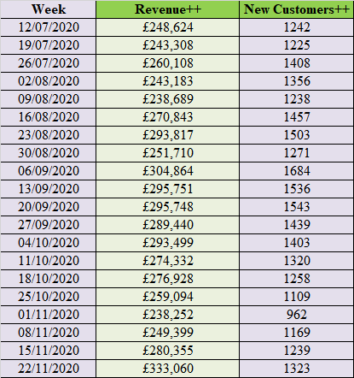
Some Projections – Based on web team summary
Based on £1,307.00 per week increase

Slide 19
How will they fit in?
Likely initially remote.
An SEO manager that would effectively be his own department, 1 man army! But together both would constitute an SEO team
The developer would sit within the brand team (suggested by Claire)
Storypointing meetings are open to attend and spec'ing would be usually handled by the SEO manager and delegated to the developer
If things do go well activities can potentially be scaled up to help Route1Print for shared financial benefit.

Slide 20
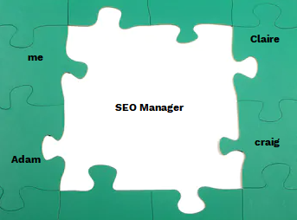
Final Thoughts/Any Questions

